Slide 1
Concurrency
Saint Petersburg, 2019

Slide 2
Content
1
Hardware basics
2
Software basics
3
Java thread management
4
Concurrency general concept
5
Java concurrency implementation
6
Conclusion

Slide 3
Concurrent computing is a form of computing in which several computations are executed during overlapping time periods—concurrently—instead of sequentially (one completing before the next starts)
Definition

Slide 4
Hardware basics

Slide 5
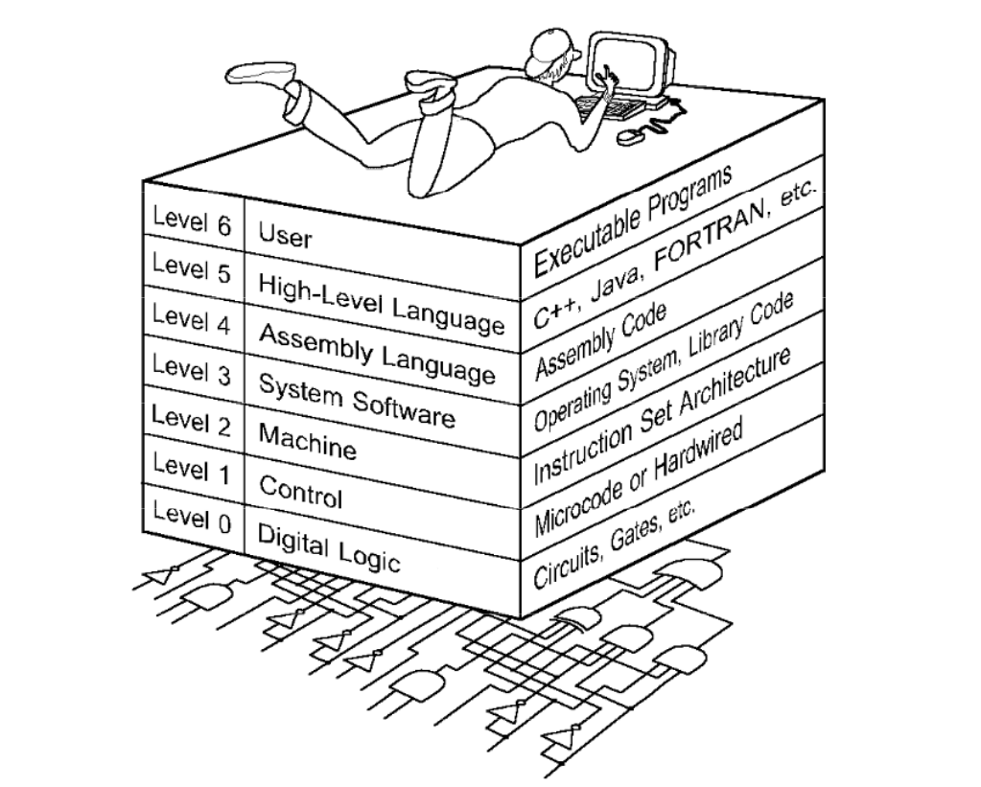
The World we are living in

Slide 6
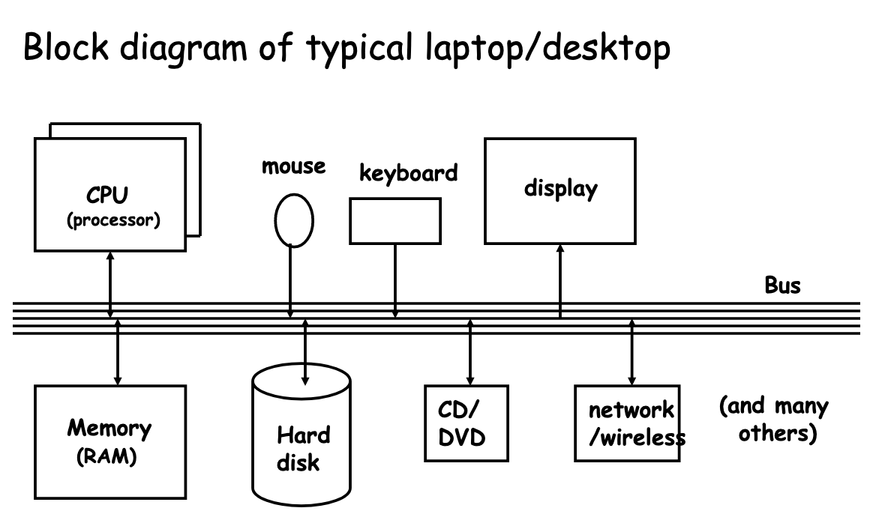
Computer architecture

Slide 7
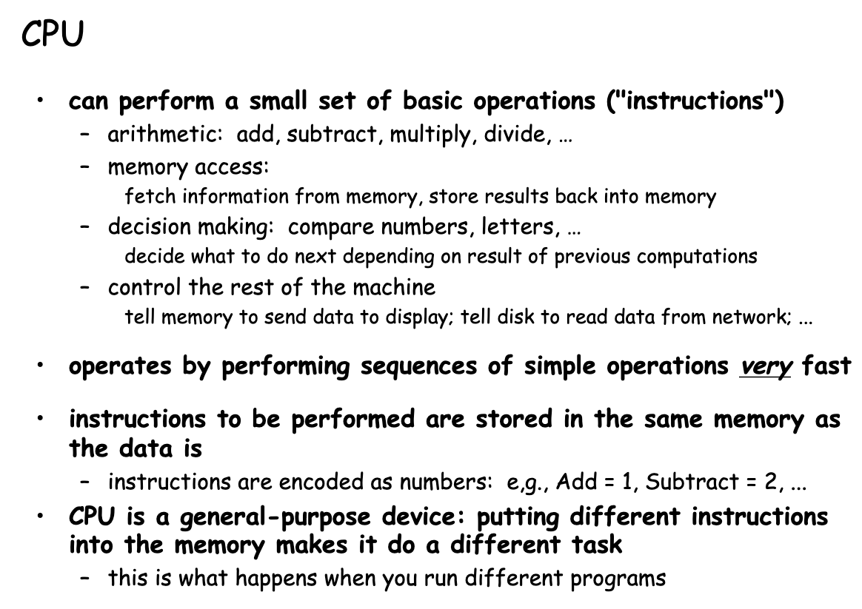
CPU

Slide 8
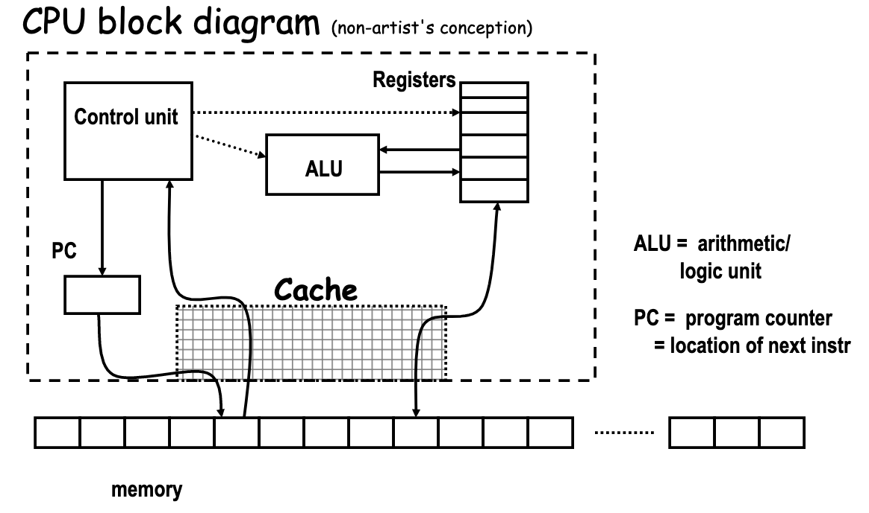
CPU

Slide 9
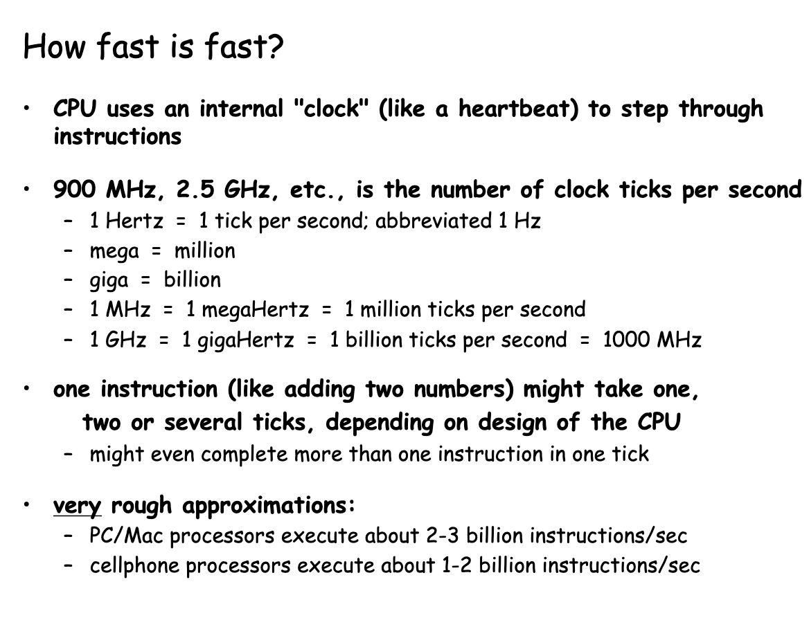
CPU

Slide 10
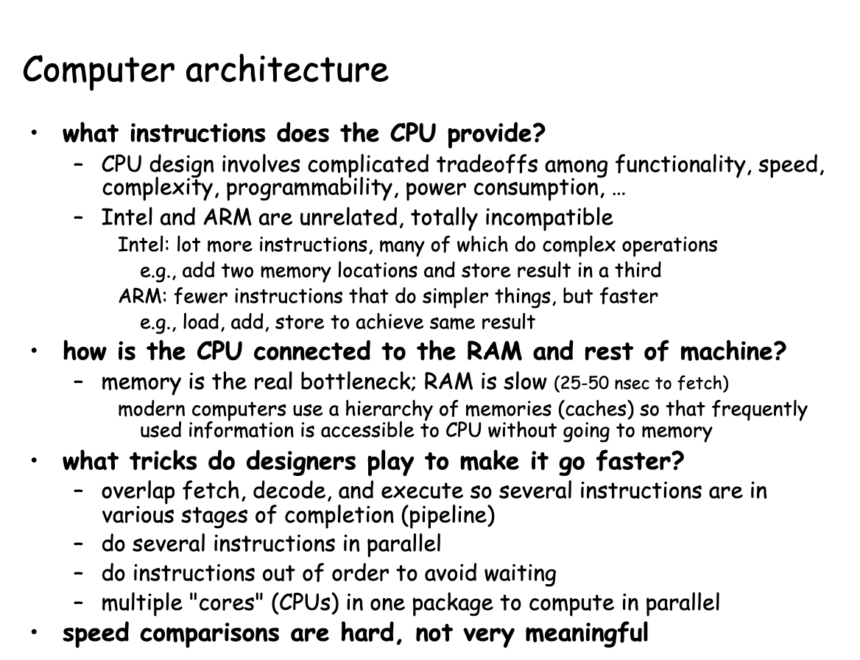
Computer architecture

Slide 11
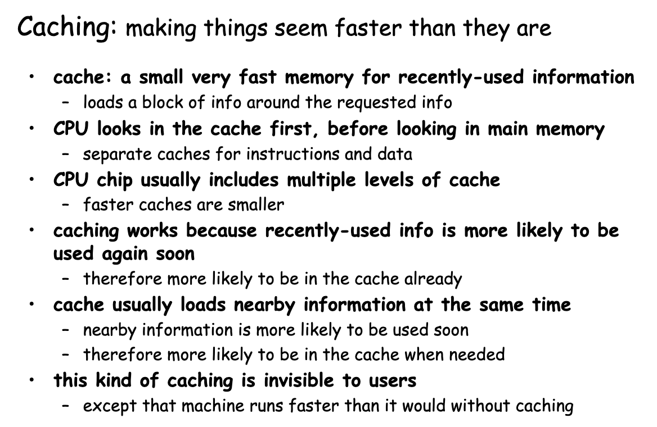
CPU caching

Slide 12
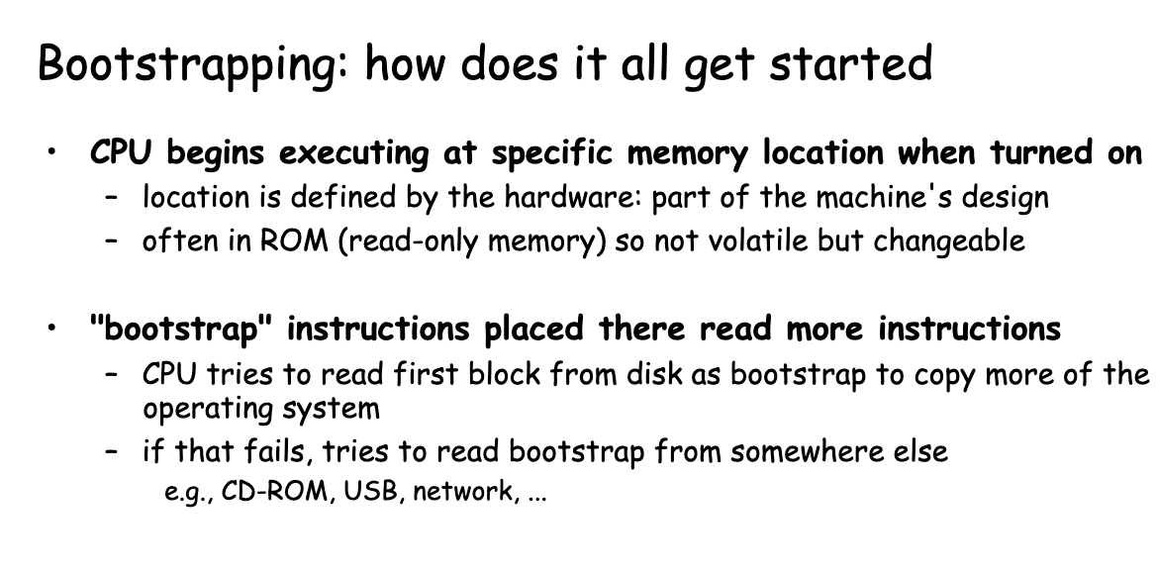
Bootstrapping

Slide 13
Software basics

Slide 14
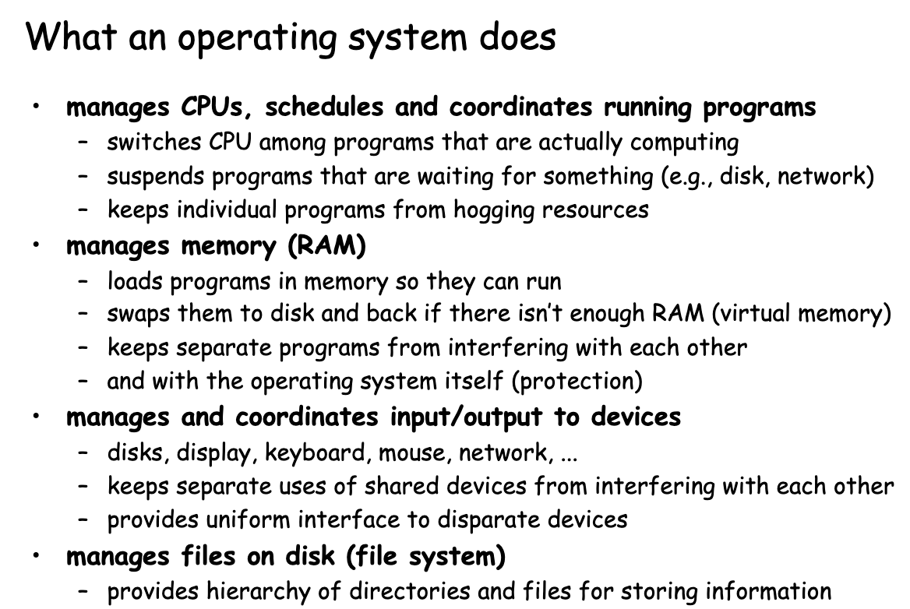
OS

Slide 15
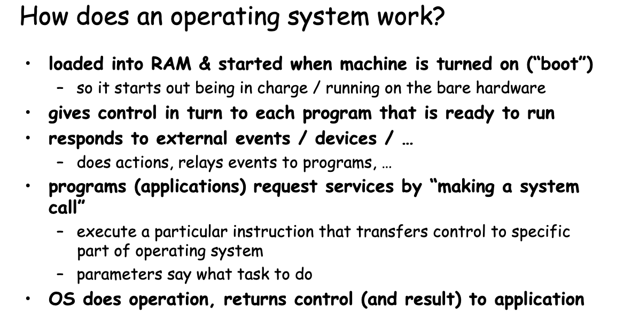
OS

Slide 16
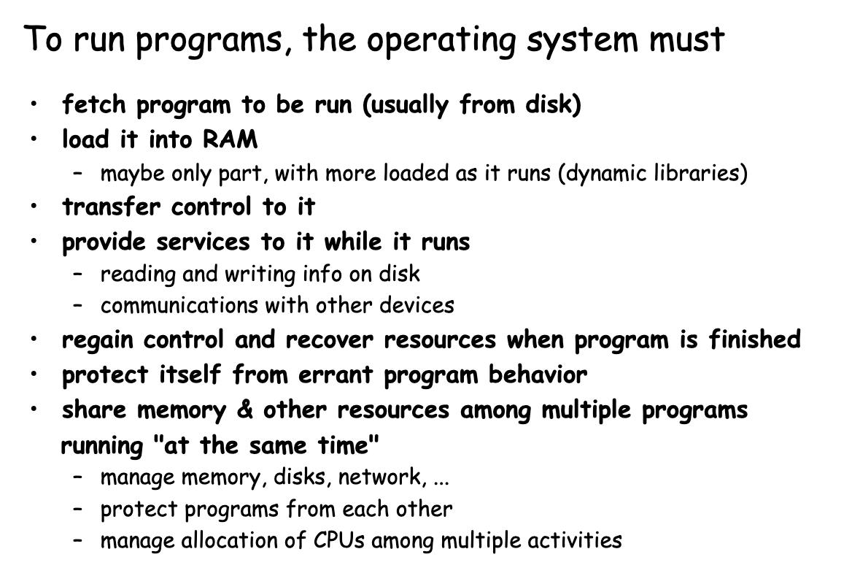
How to run programs?

Slide 17
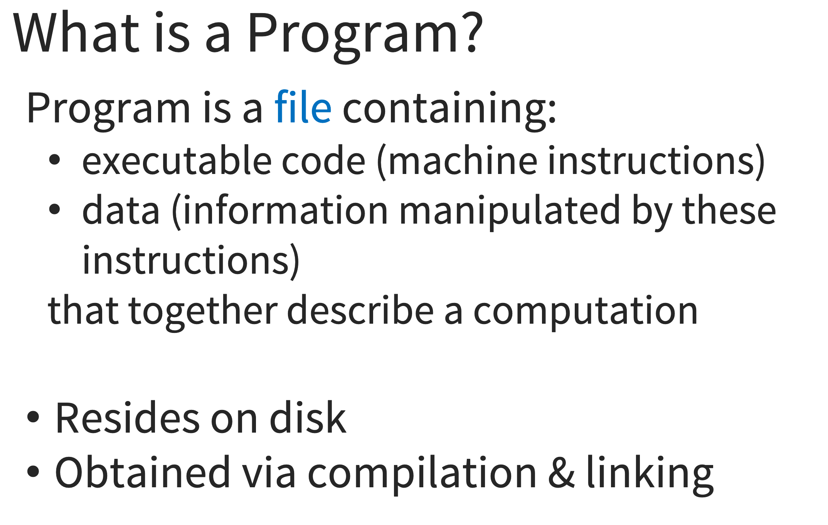
Programs

Slide 18
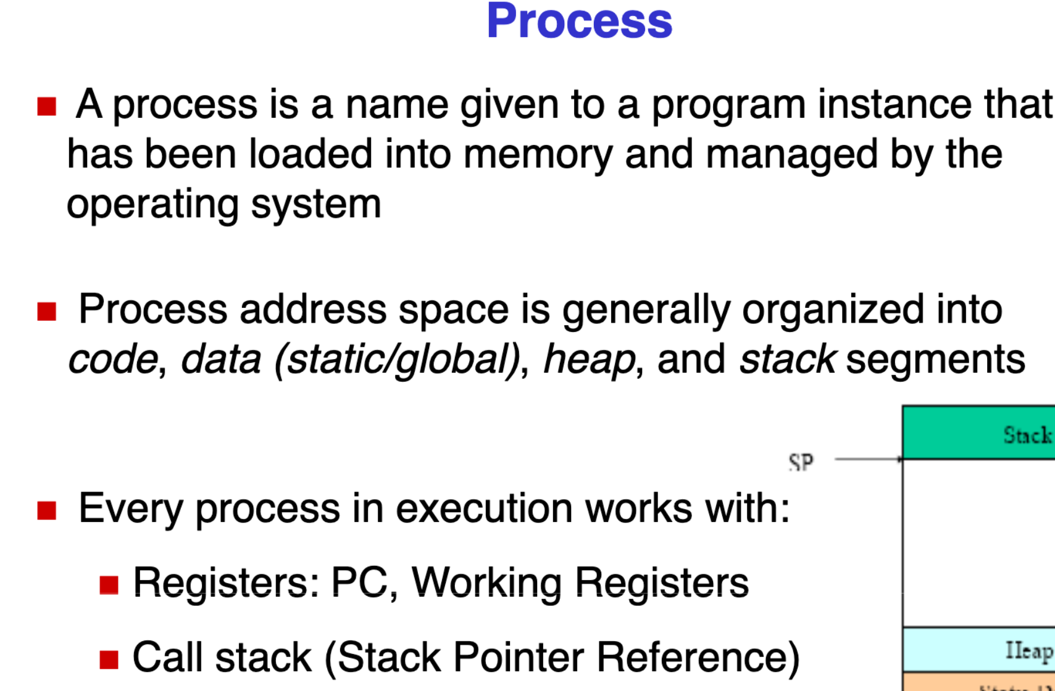
Process

Slide 19
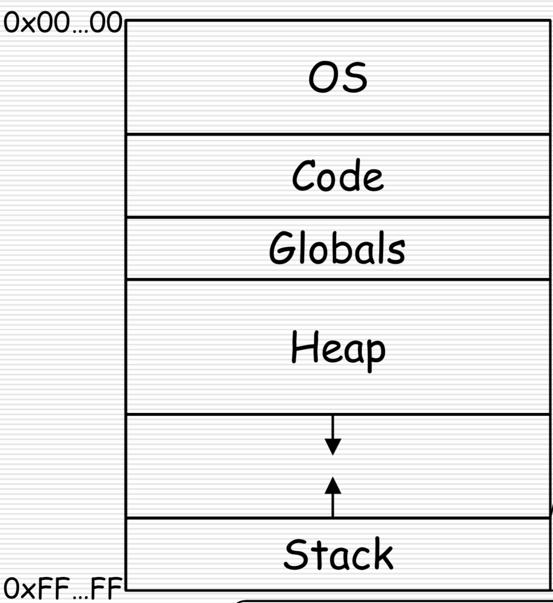
Process

Slide 20
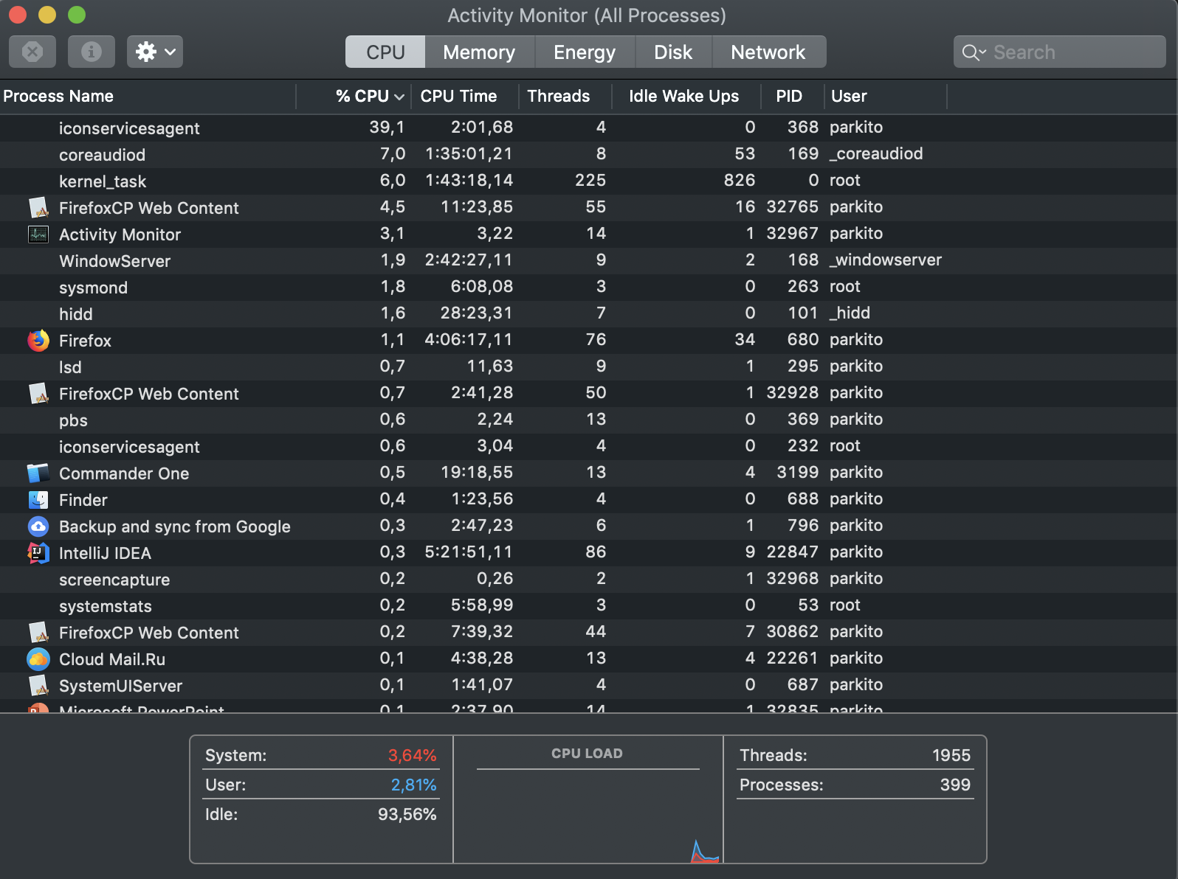
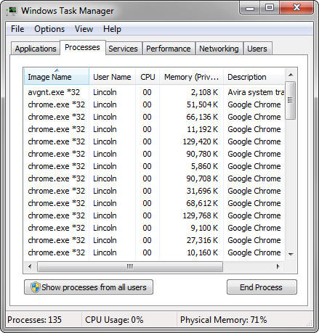
Processes

Slide 21
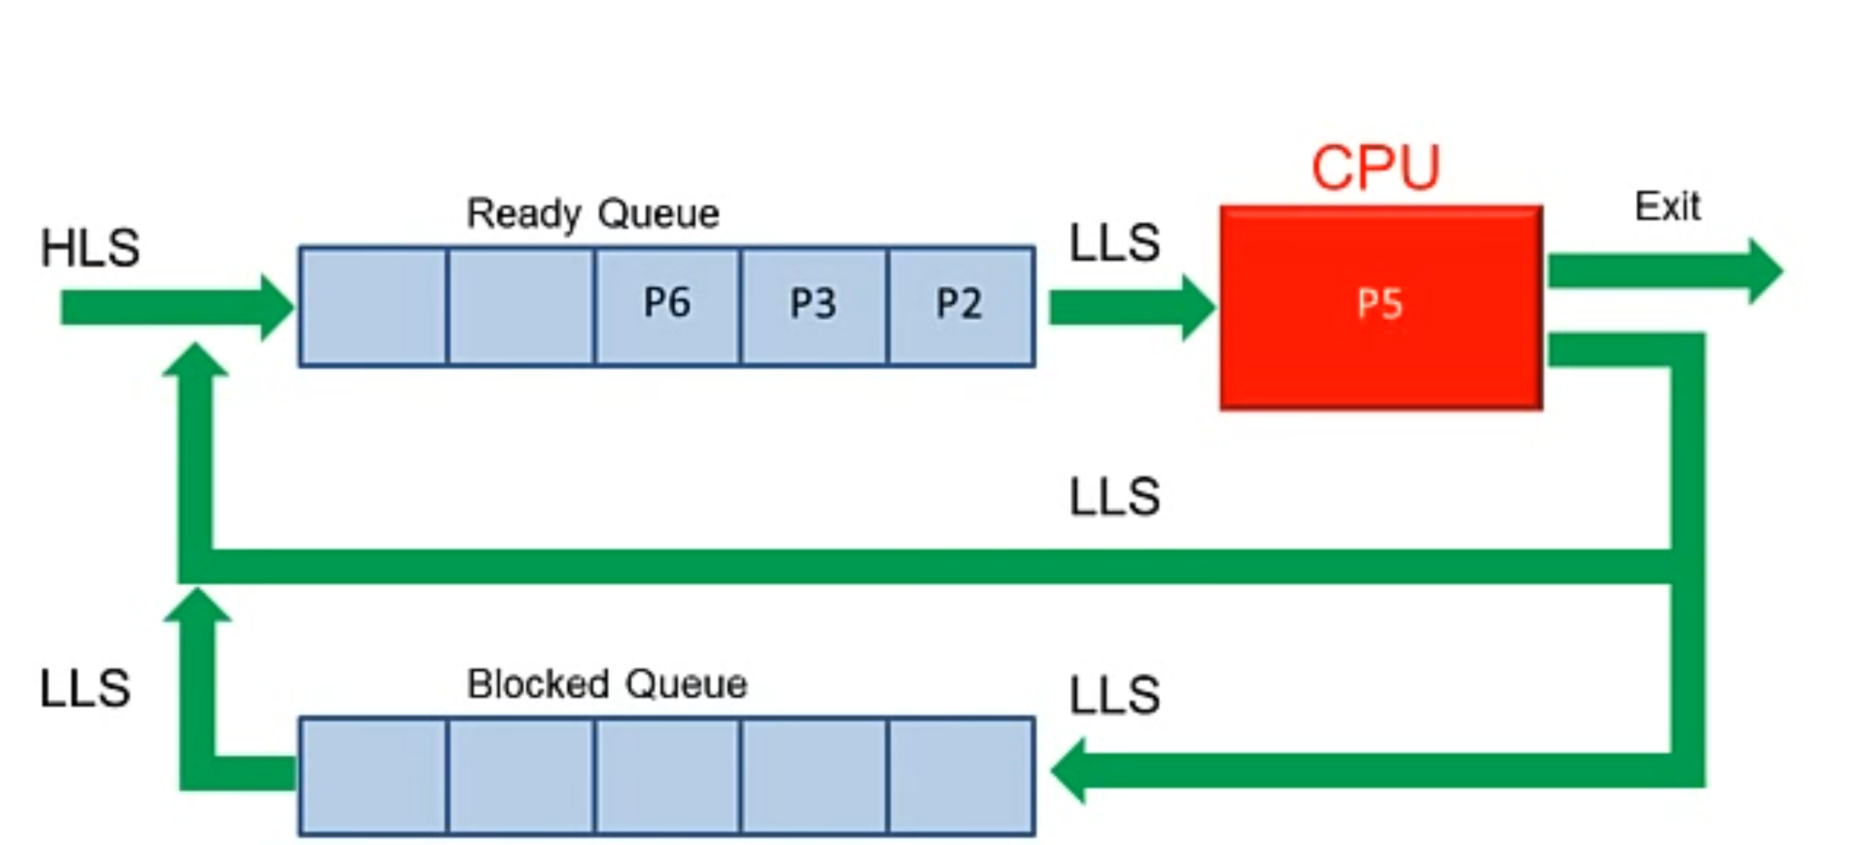
Process scheduler

Slide 22
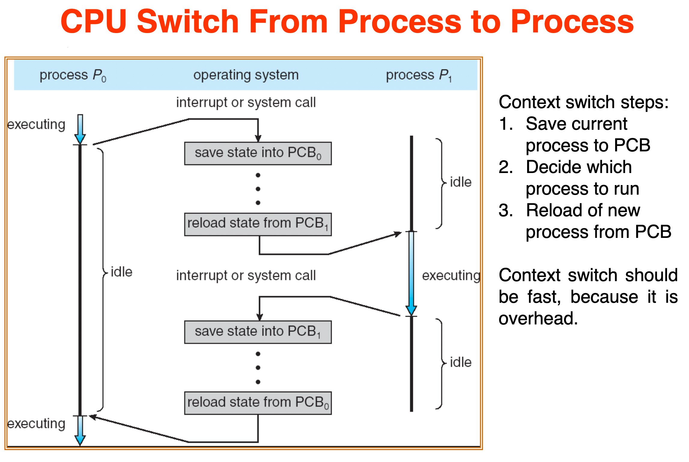
Process scheduler

Slide 23
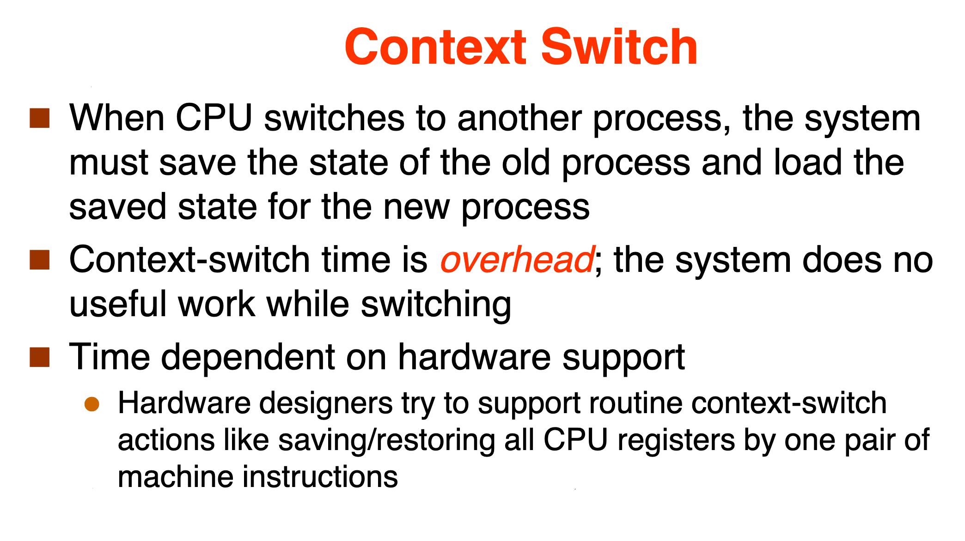
Context switching

Slide 24
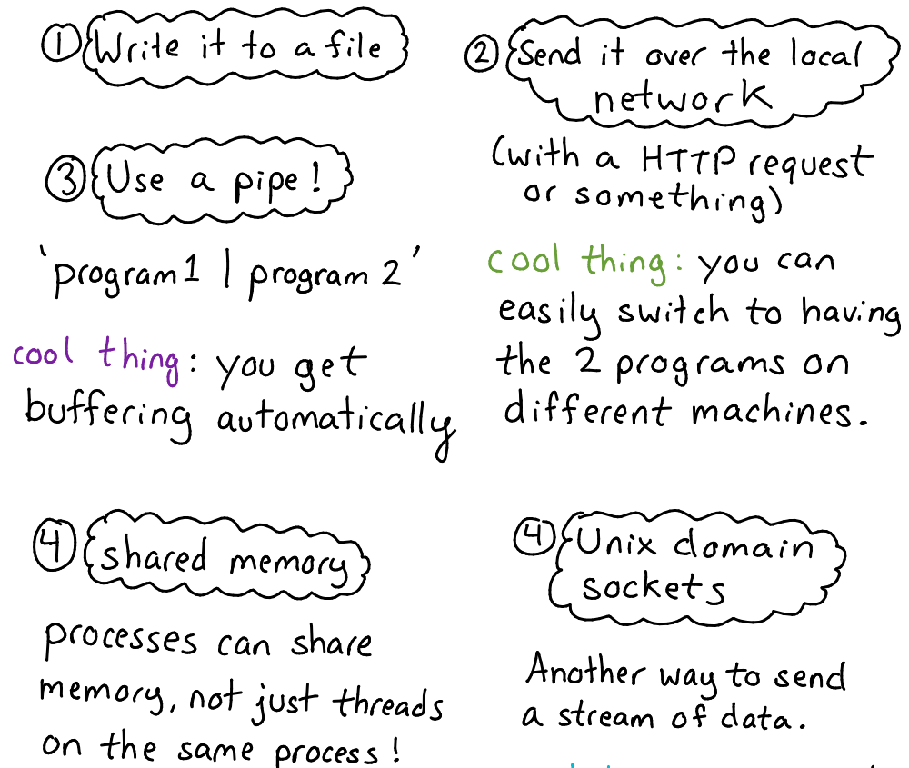
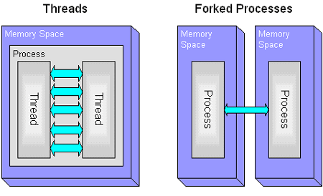
Inter-process communications

Slide 25
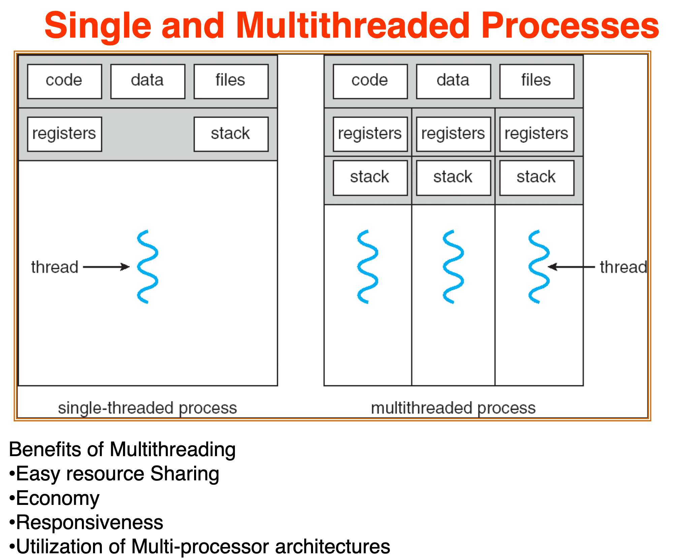
Threads

Slide 26
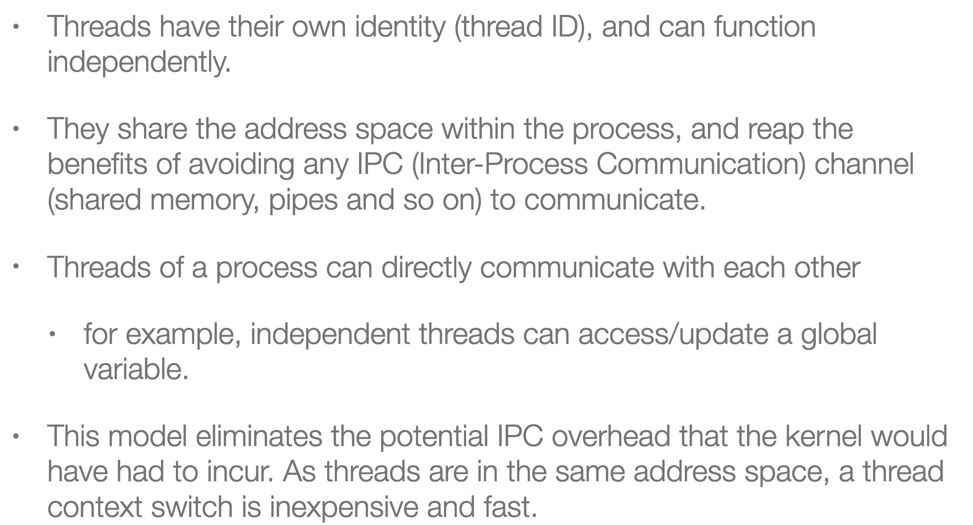
Threads

Slide 27
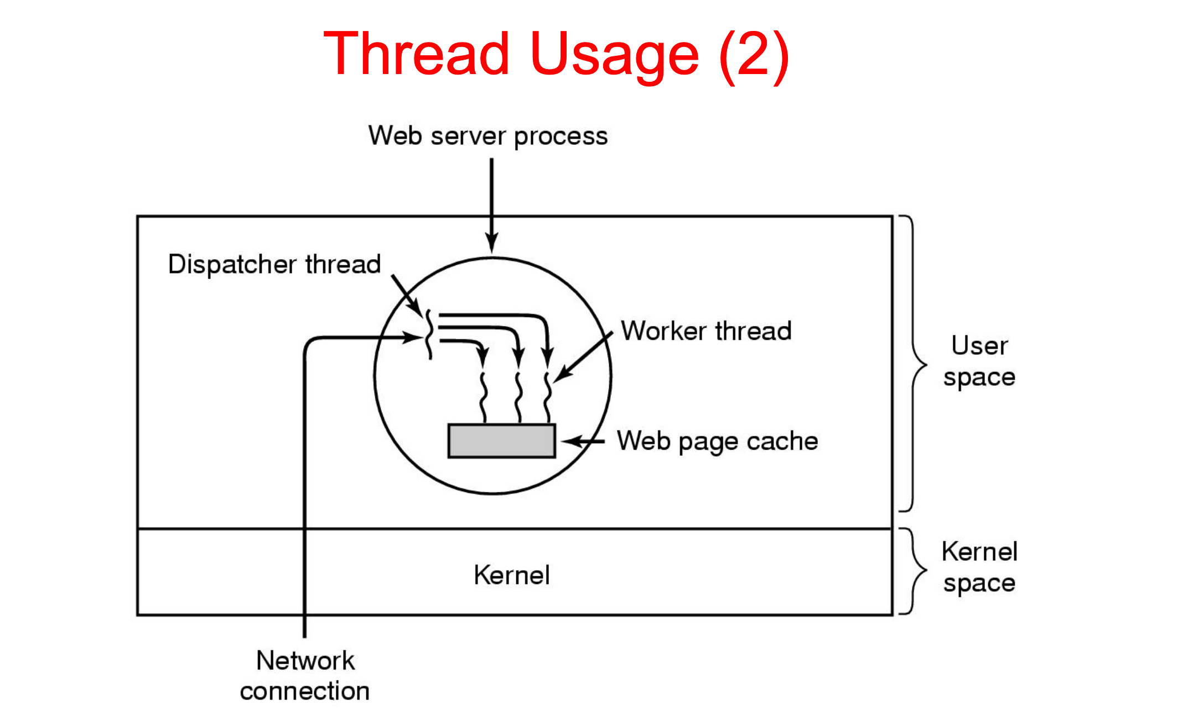
Threads

Slide 28
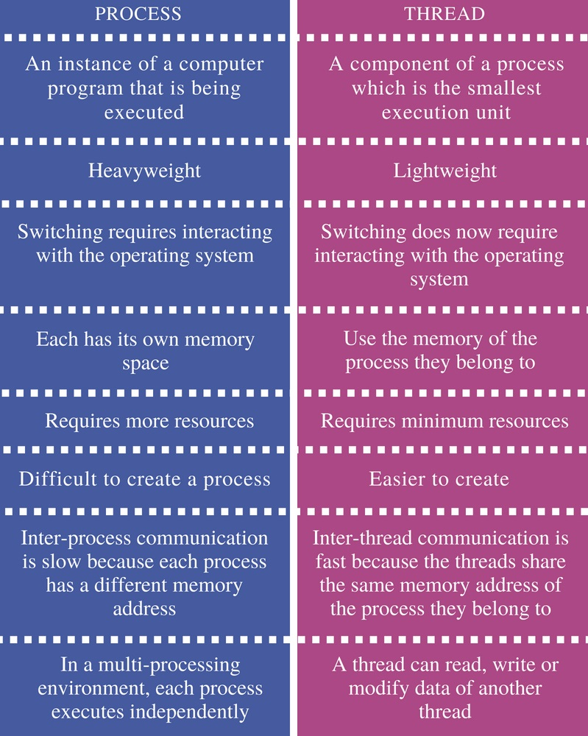
Threads

Slide 29
Java basics

Slide 30
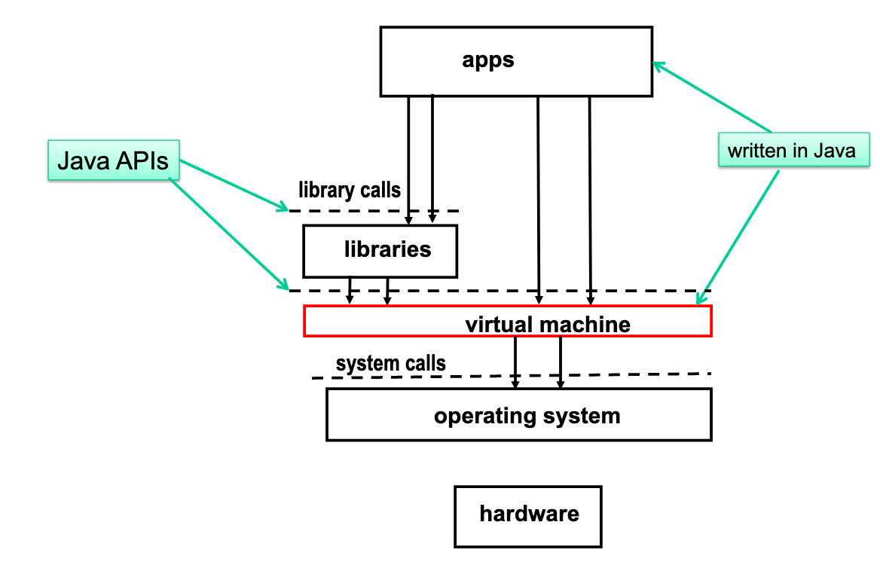
JVM execution architecture

Slide 31
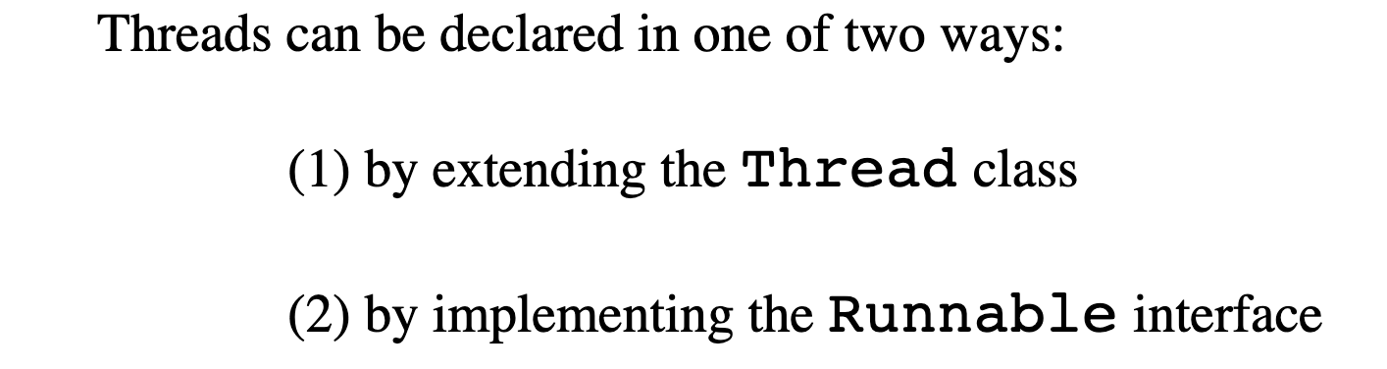
Thread creation

Slide 32
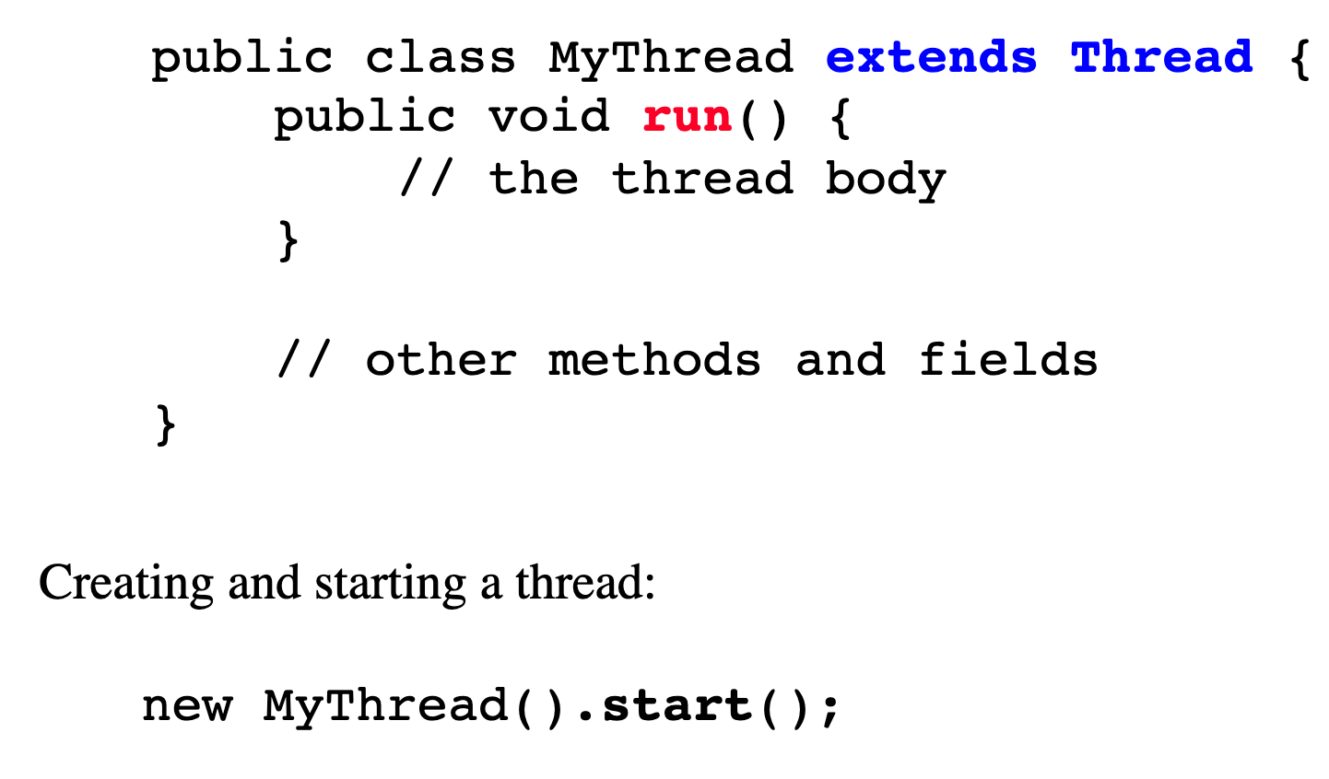
Thread creation

Slide 33
Thread creation

Slide 34
Example 1,2,3

Slide 35
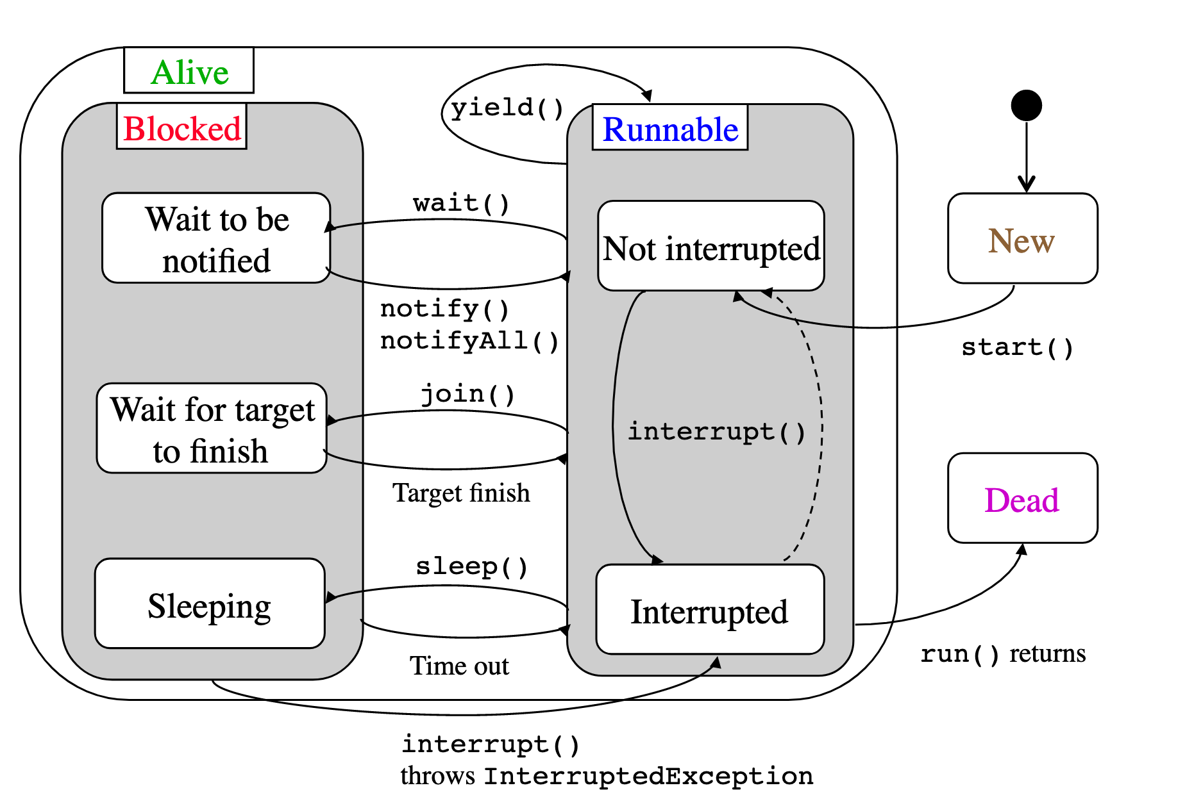
Thread life cycle

Slide 36
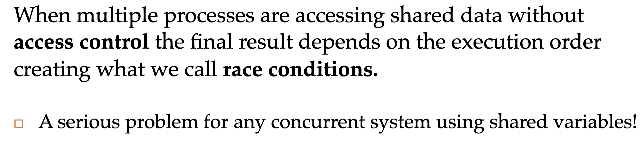
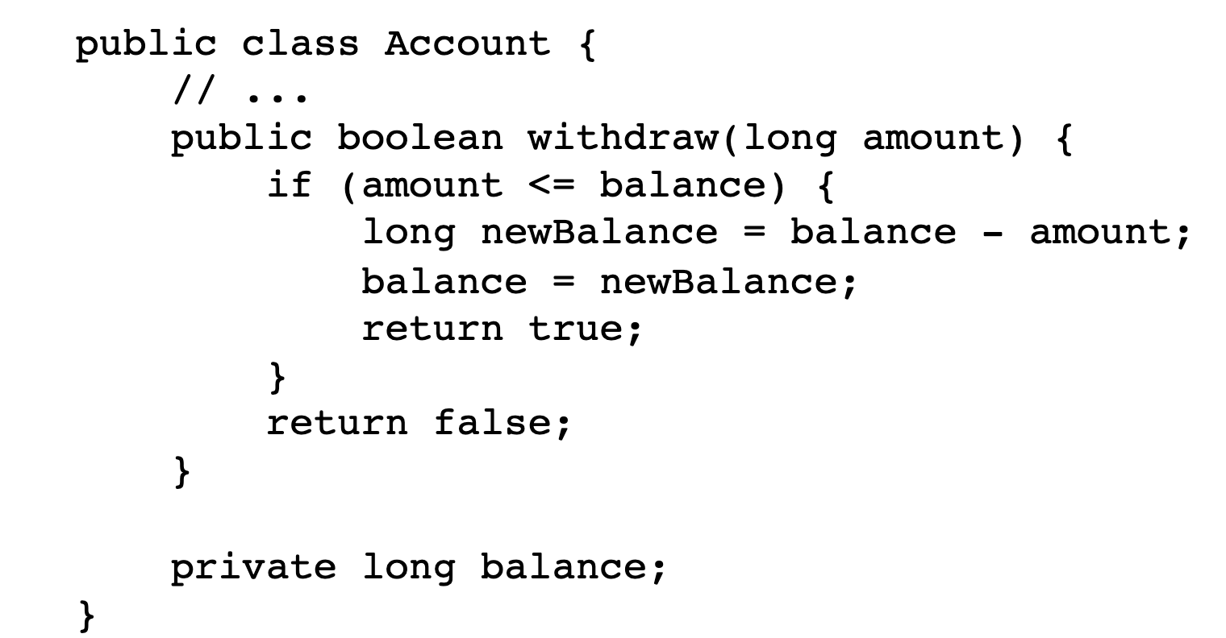
Race condition

Slide 37
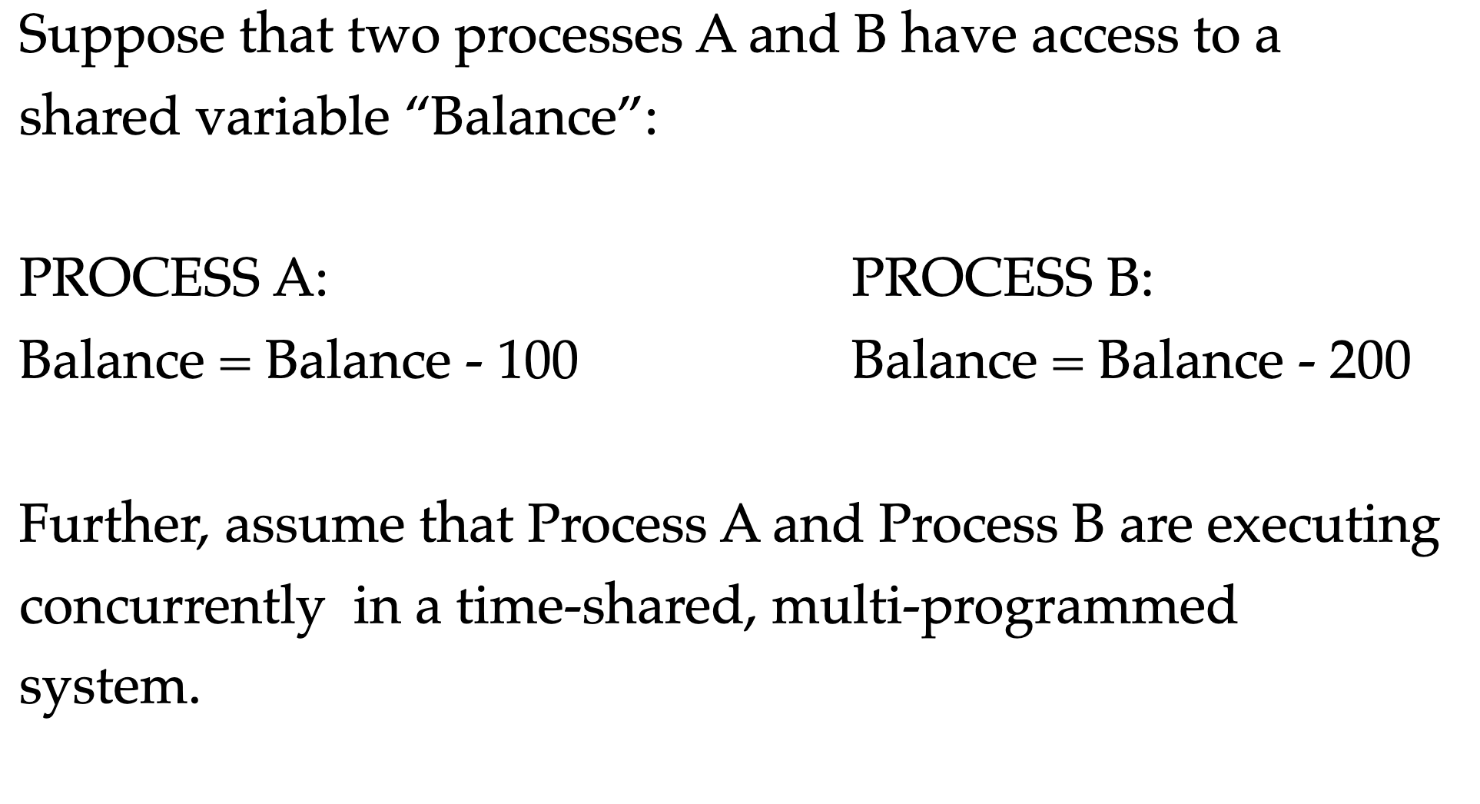
Race condition
threads
Thread A:
Thread B:
Thread
Thread

Slide 38
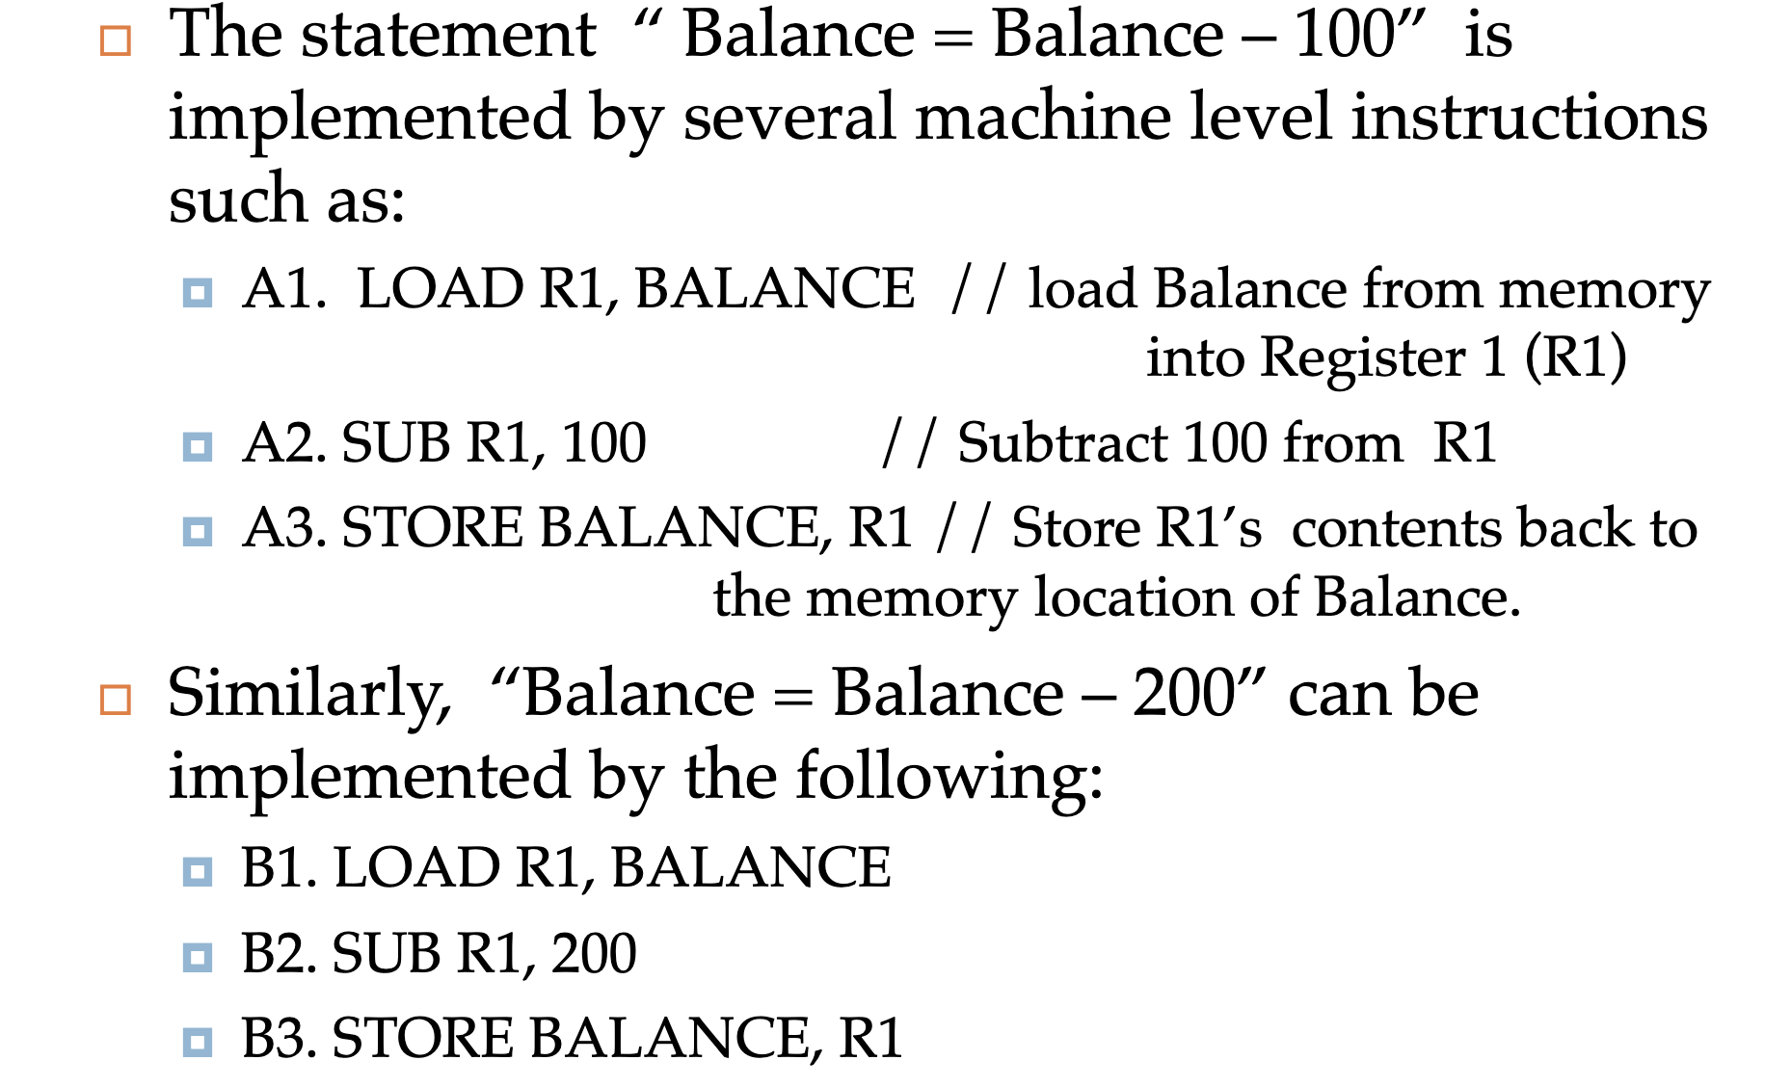
Race condition

Slide 39
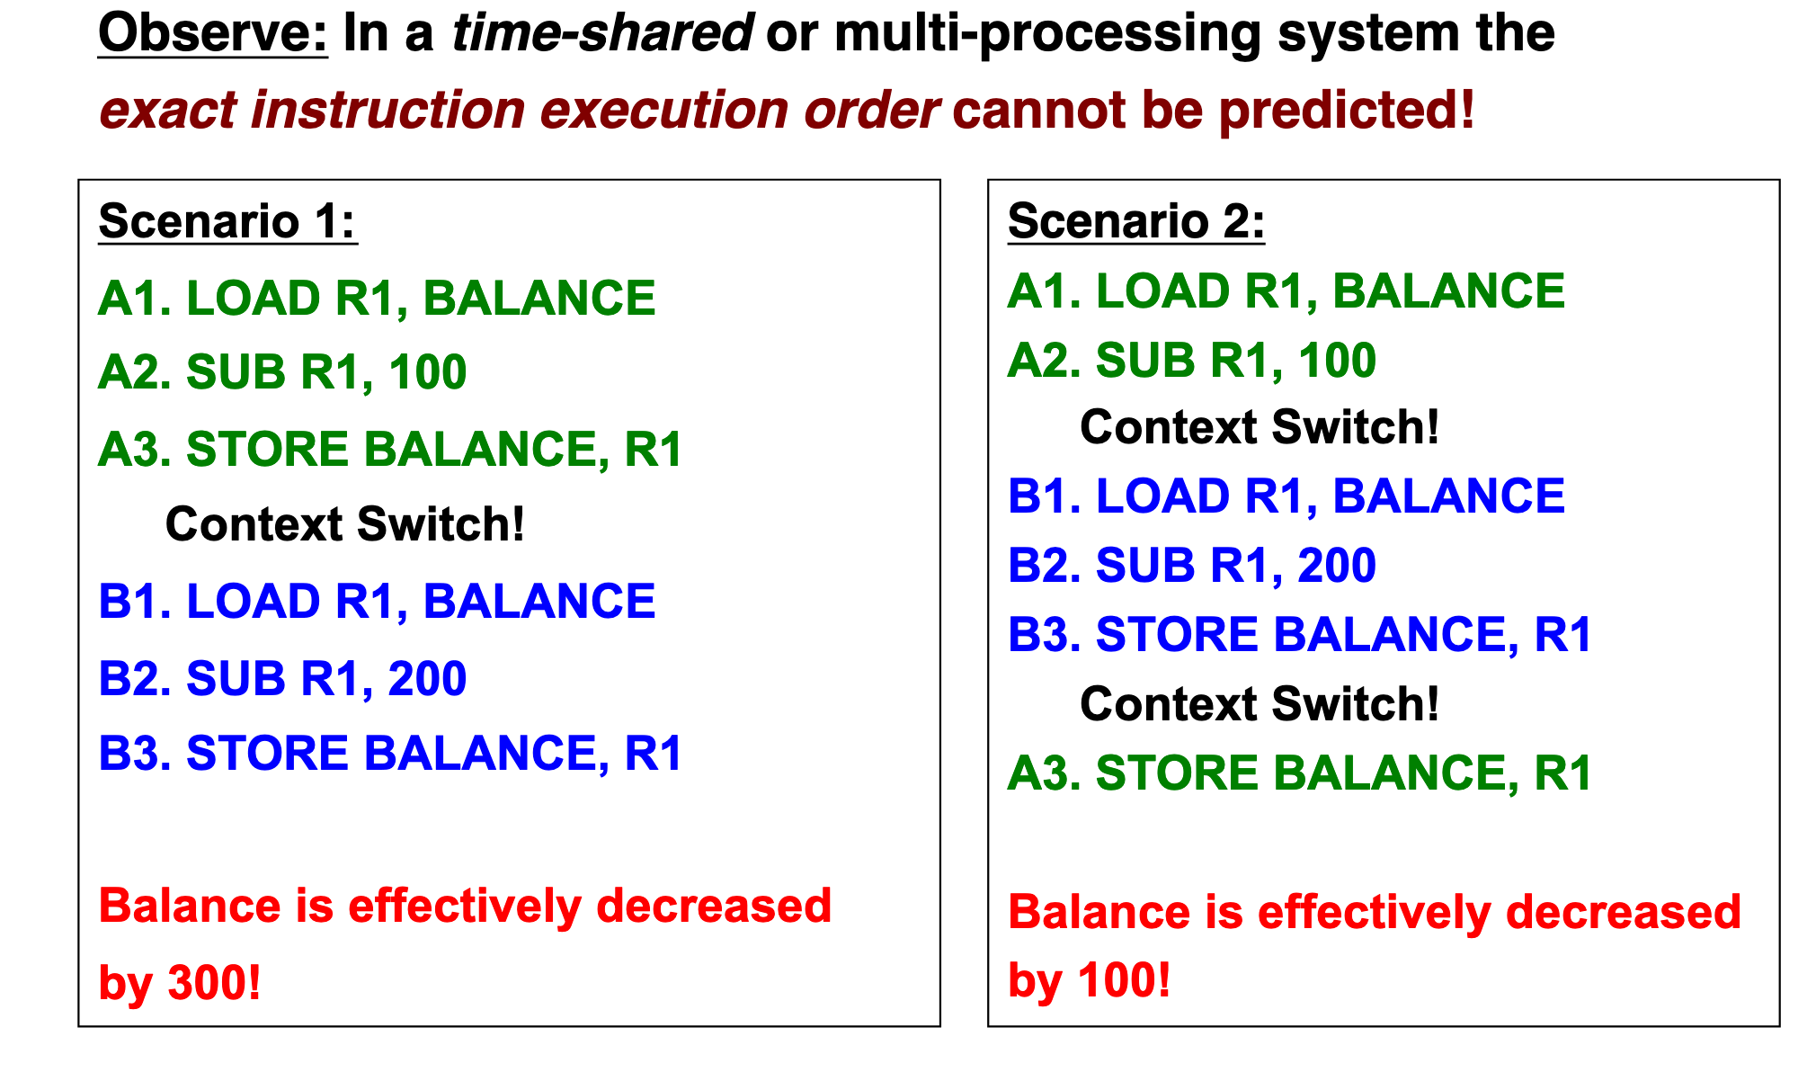
Race condition

Slide 40
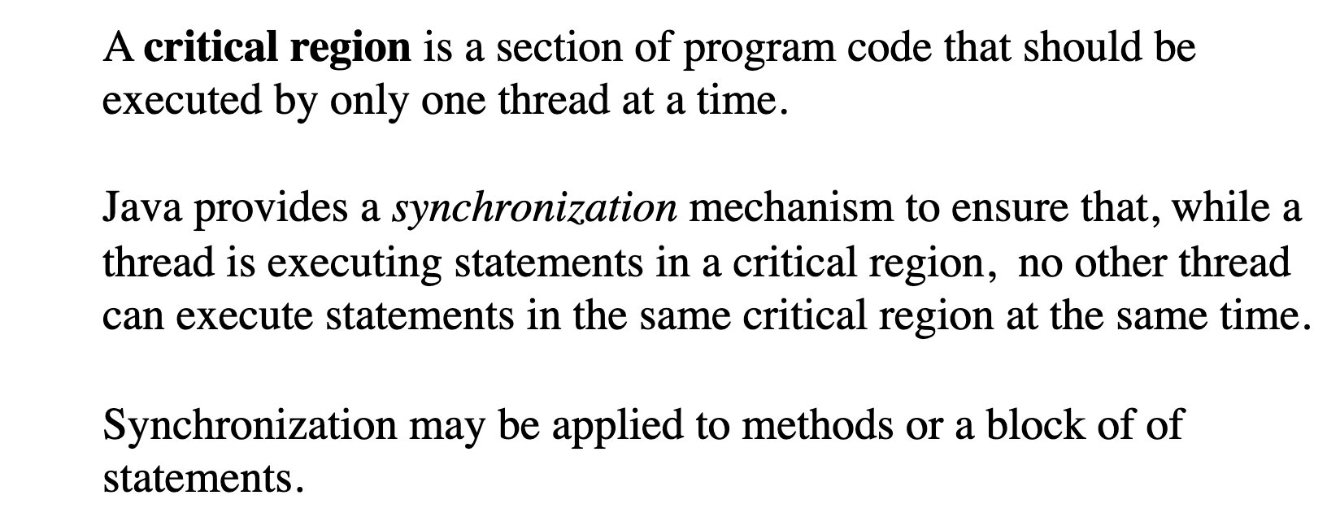
Critical region (section)

Slide 41
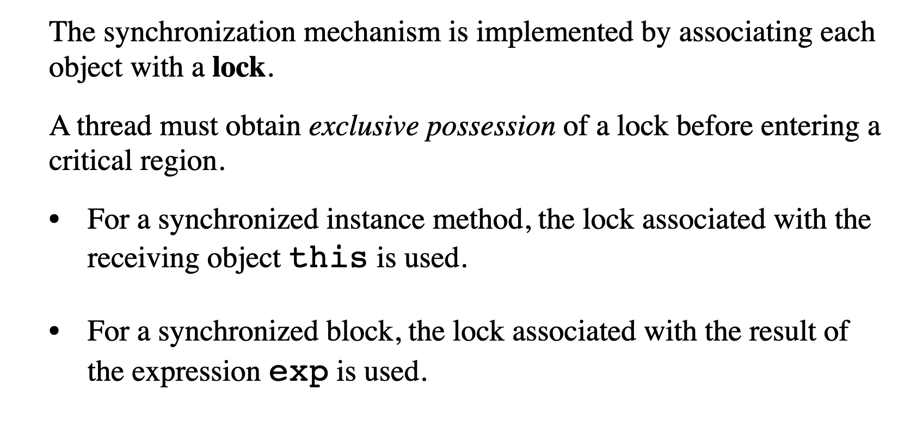
Lock (monitor)

Slide 42
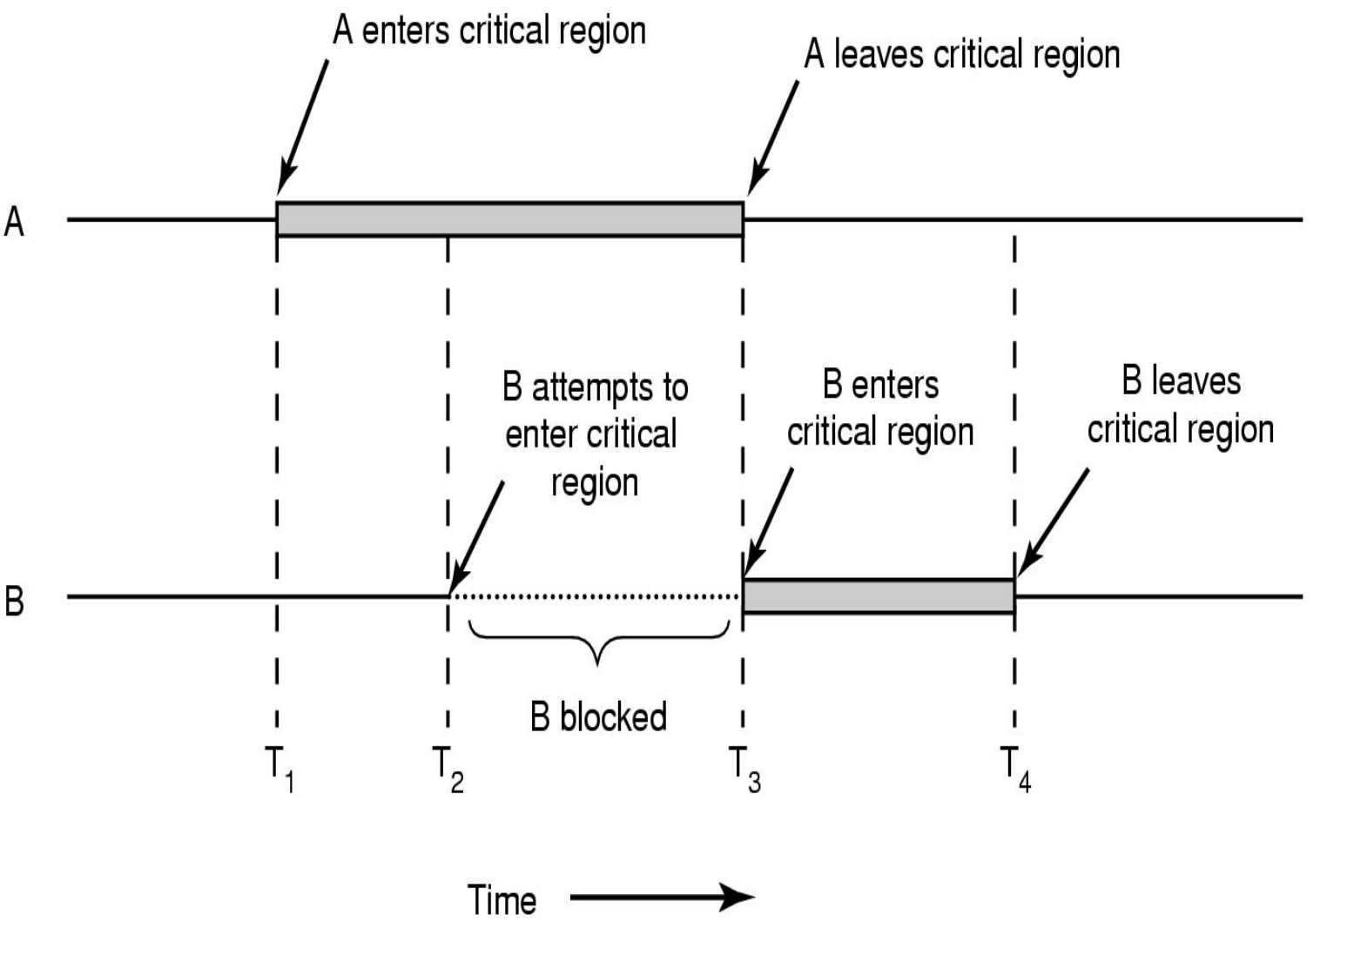
Lock (monitor)

Slide 43
Example 4

Slide 44
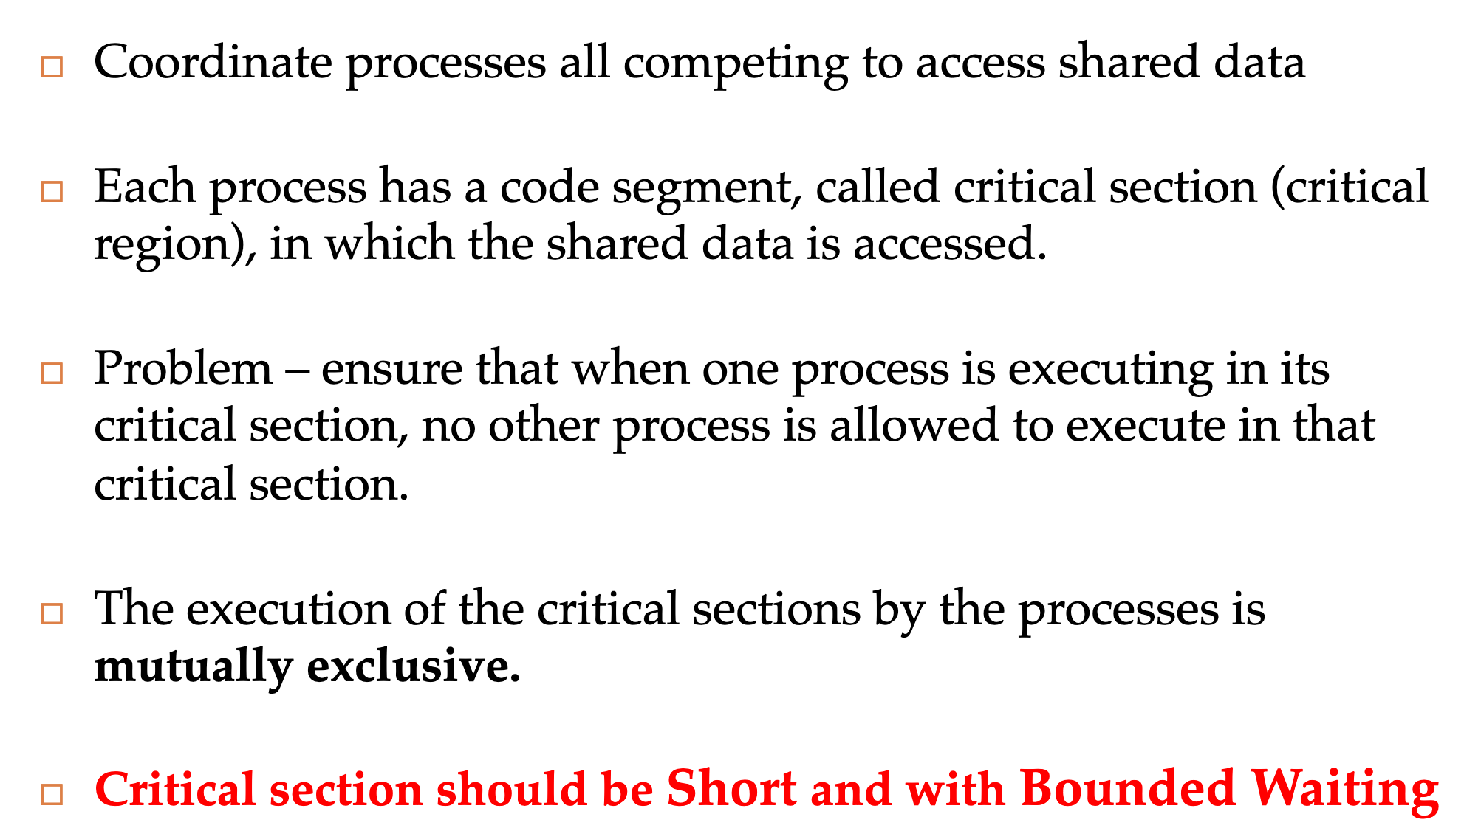
Synchronization

Slide 45
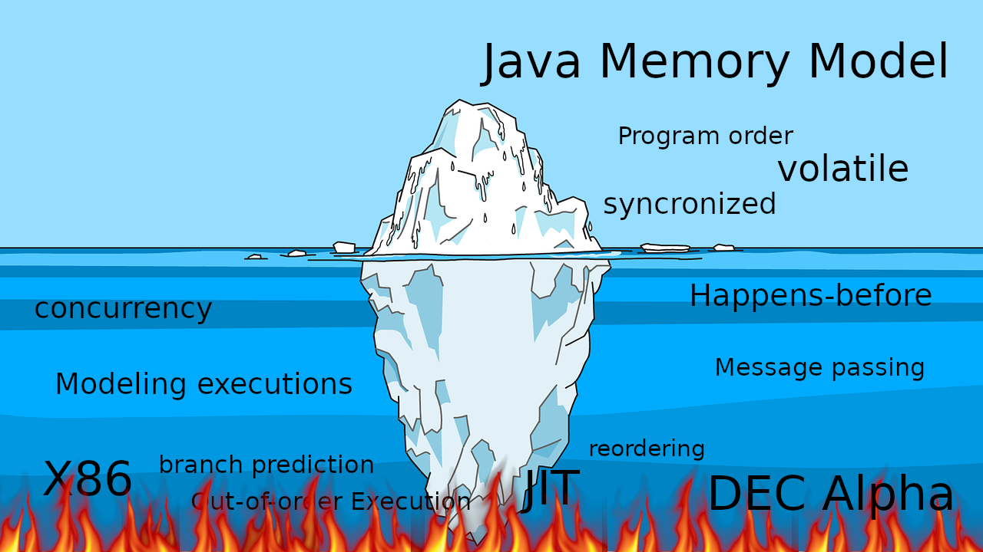
JMM

Slide 46
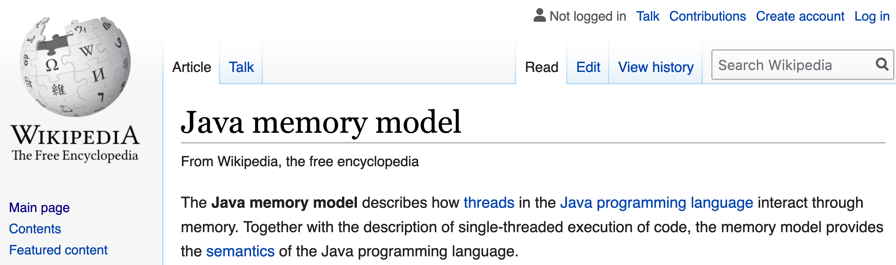
JMM

Slide 47
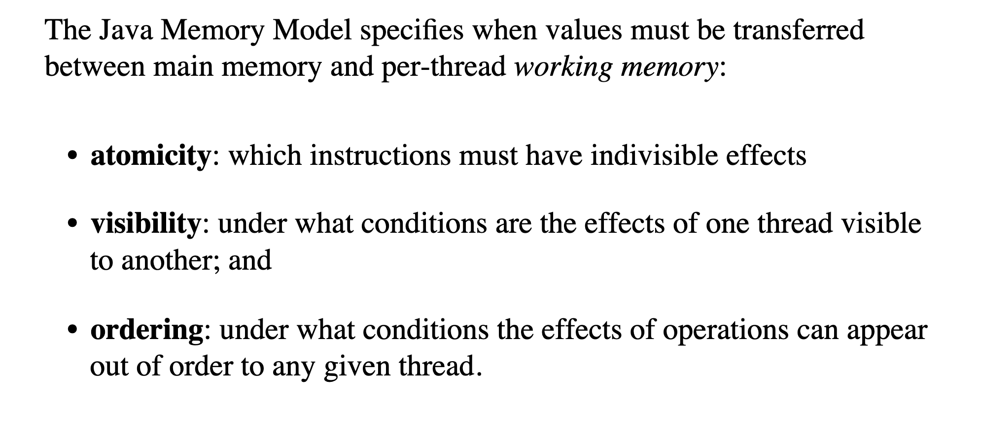
Model properties

Slide 48
CPU

Slide 49
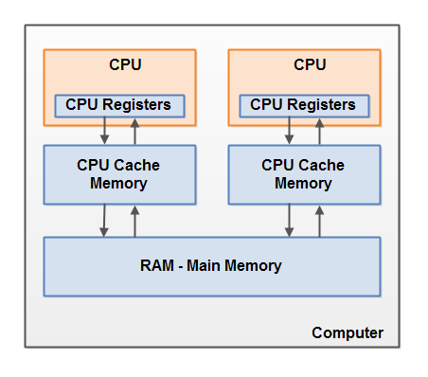
CPU

Slide 50
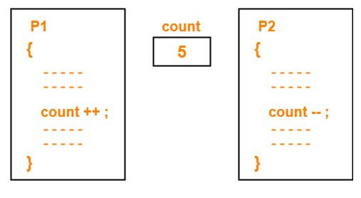
Atomicity

Slide 51
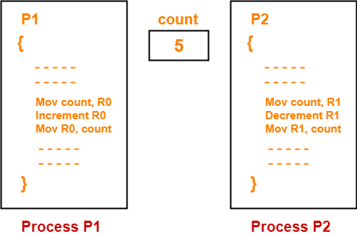
Atomicity

Slide 52
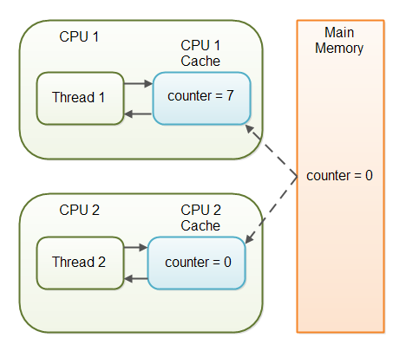
Visibility

Slide 53
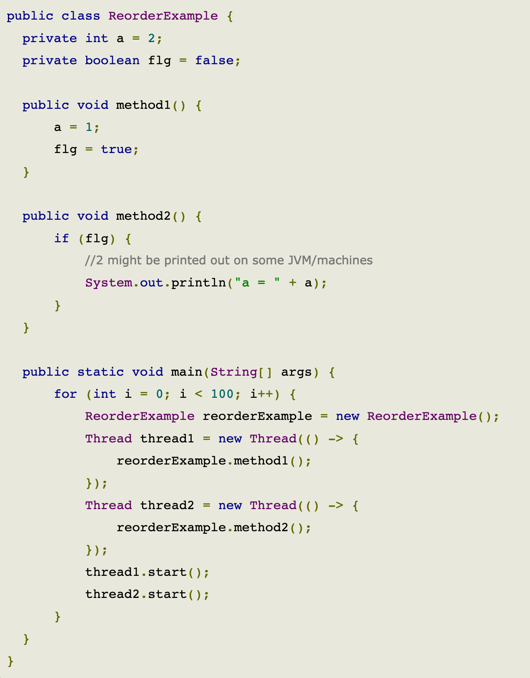
Reordering

Slide 54
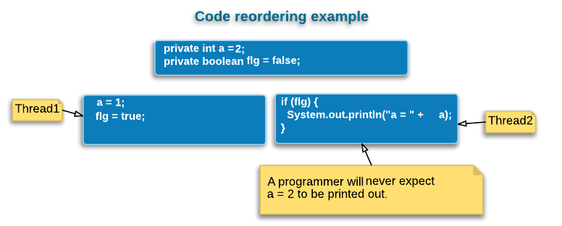
Reordering

Slide 55
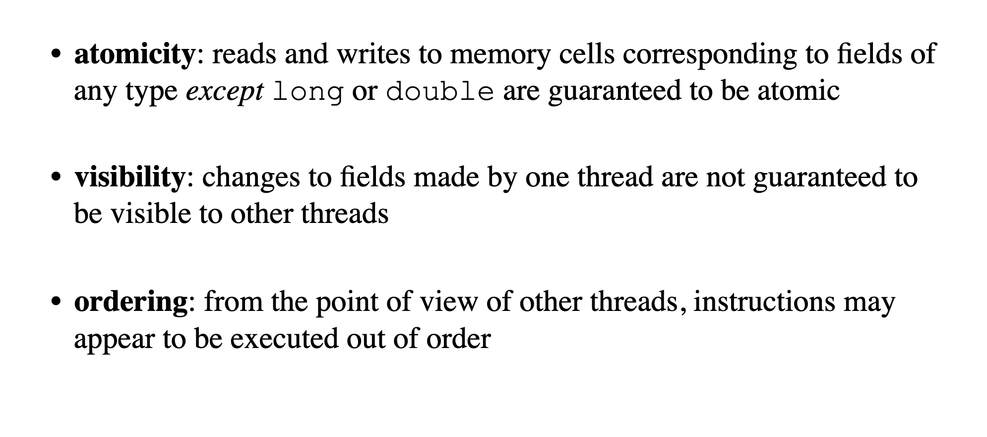
Model properties

Slide 56
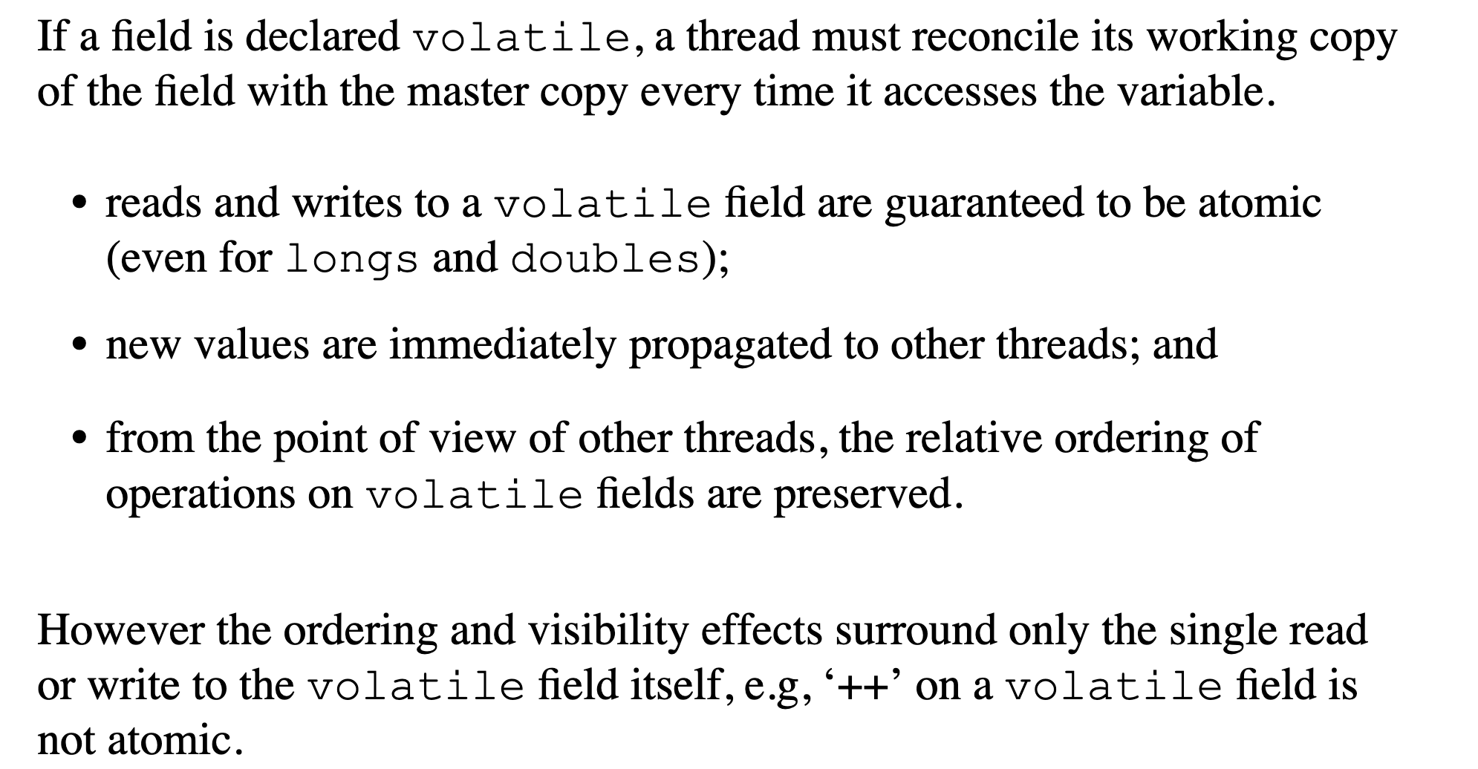
Volatile

Slide 57
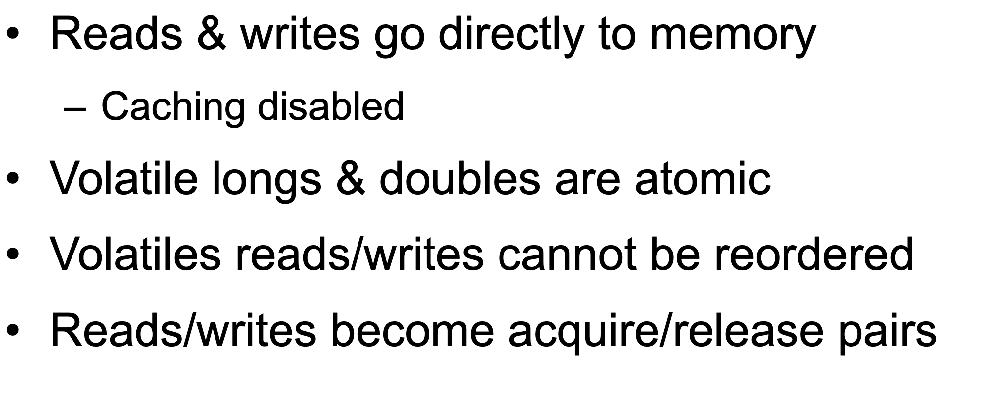
Volatile

Slide 58
Happens before
Happens-before relationship is a guarantee that action performed by one thread is visible to another action in different thread.
Transitivity: If A happens-before B, and B happens-before C, then A happens-before C.

Slide 59

Single thread rule
Single thread rule: Each action in a single thread happens-before every action in that thread that comes later in the program order.

Slide 60

Monitor rule
Monitor lock rule: An unlock on a monitor lock (exiting synchronized method/block) happens-before every subsequent acquiring on the same monitor lock.

Slide 61

Volatile rule
Volatile variable rule: A write to a volatile field happens-before every subsequent read of that same field. Writes and reads of volatile fields have similar memory consistency effects as entering and exiting monitors (synchronized block around reads and writes), but without actually acquiring monitors/locks.

Slide 62

Thread start rule
Thread start rule: A call to Thread.start() on a thread happens-before every action in the started thread. Say thread A spawns a new thread B by calling thread A.start(). All actions performed in thread B's run method will see thread A's calling thread A.start() method and before that (only in thread A) happened before them.

Slide 63

Thread join rule
Thread join rule: All actions in a thread happen-before any other thread successfully returns from a join on that thread. Say thread A spawns a new thread B by calling threadA.start() then calls threadA.join(). Thread A will wait at join() call until thread B's run method finishes. After join method returns, all subsequent actions in thread A will see all actions performed in thread B's run method happened before them.

Slide 64

Thread safety
thread safety = atomicity + visibility

Slide 65
Example 5,6,7

Slide 66

Thread signaling

Slide 67

Wait

Slide 68

Notify

Slide 69

Thread signaling issue

Slide 70
Example 8

Slide 71

Starvation

Slide 72

Dormancy

Slide 73

Deadlock

Slide 74

Deadlock

Slide 75

Deadlock

Slide 76

Deadlock

Slide 77
Example 9

Slide 78


Daemons

Slide 79
Conclusion

Slide 80

Sequential vs concurrent

Slide 81
Performance

Slide 82

Amdahl's law

Slide 83

Resource utilization

Slide 84

Resource utilization

Slide 85


Resource utilization

Slide 86

Latency

Slide 87

Modern way

Slide 88






Concurrent Dijkstra algorithm

Slide 89
Multi thread migration

Slide 90
Single thread migration
7h21 min 1.7 r/s

Slide 91
Multi thread migration

Slide 92
Multi thread migration
7h21 min 1.7 r/s
28 min 23 r/s

Slide 93

The show begins

Slide 94

#1 Difficult to debug

Slide 95

#2 Race condition

Slide 96

#3 Dead locks

Slide 97
Concurrency mad stuff
“But I don’t want to go among mad people," Alice remarked. - "Oh, you can’t help that," said the Cat: "we’re all mad here. I’m mad. You’re mad." - "How do you know I’m mad?" said Alice. - "You must be," said the Cat, "or you wouldn’t have come here.”
Alice's Adventures in
Wonderland by Lewis Carroll

Slide 98


Dev practices
On Java 8 by Bruce Eckel

Slide 99


Dev practices
On Java 8 by Bruce Eckel

Slide 100

#4 Non deterministic behavior

Slide 101

#4 Non deterministic behavior

Slide 102

#4 Non deterministic behavior

Slide 103

#4 Non deterministic behavior

Slide 104
Are you still here?
Twas brillig, and the slithy toves Did gyre and gimble in the wabe: All mimsy were the borogoves, And the mome raths outgrabe
Jabberwocky by Lewis Carroll

Slide 105

Let’s continue?

Slide 106

#5 Performance degradation

Slide 107

#5 Performance degradation

Slide 108

#6 OS limitation

Slide 109

Stop it? Hell no…

Slide 110

#7 Hardware unpredictable optimizations

Slide 111

Concurrency in real world
On Java 8 by Bruce Eckel

Slide 112
Conclusion
Concurrency is powerful practice, you can achieve a lot using it
Don’t use concurrency if you can avoid it
Use best practices by experts
Use frameworks with big professional community
Minimize synchronization and data sharing
Perform load and stress testing
Use as much as possible existed solutions
Don’t forget about mad world and wonders

Slide 113
Resources
Java concurrency in practice (Brian Goetz )
On Java 8 (Bruce Eckel)
The Art of Multiprocessor Programming (Maurice Herlihy , Nir Shavit )

Slide 114

THANK YOU!
artyom-karnov@yandex.ru, Saint-Petersburg, 2019

